Slide 1

INSTITUTE - UIE
DEPARTMENT- ACADEMIC UNIT-2
Bachelor of Engineering (Computer Science & Engineering)
Subject Name: Introduction to Problem Solving
Code:22CSH-101
Conditional Operator and GOTO
DISCOVER . LEARN . EMPOWER

Slide 2

COURSE OBJECTIVES
OBJECTIVES
The course aims to provide exposure to problem solving with programming
The course aims to raise the programming skills of students via logic building capability
With the knowledge of C language students would be able to model real world problems

Slide 3



CO Number | Course Outcome
CO1 | Remember the concepts related to fundamentals of C language, draw flowcharts and write algorithm/pseudocode.
CO2 | Understand the way of execution and debug programs in C language.
CO3 | Apply various constructs, loops, functions to solve mathematical and scientific problem.
CO4 | Analyze the dynamic behavior of memory by the use of pointers.
CO5 | Design and develop modular programs for real world problems using control structure and selection structure.

Slide 4
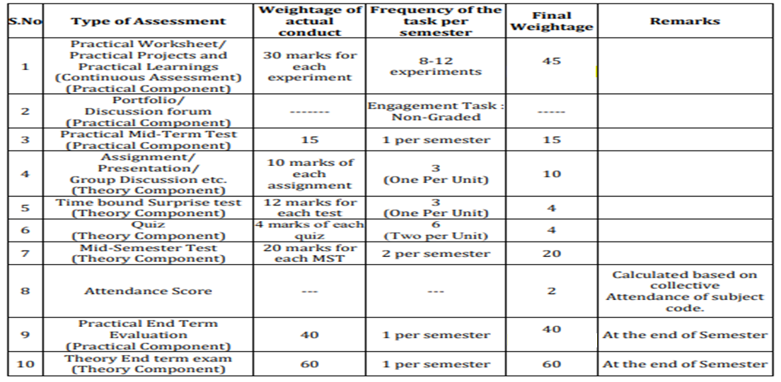
Evaluation scheme

Slide 5
WHY & WHEN ?
Sometimes we require shifting of program flow from one statement to another as per our requirement so we use goto statements & conditional operator helps to reduce the time by making code optimization
HOW ?
Both conditional operator and goto statements have their own structure in which they operate

Slide 6
RESOURCES & LEARNING DIRECTIONS
A WALKTHROUGH
To what is goto statement
To the syntax of goto statement
To the structure execution of goto
To what is conditional operator
To why conditional and its structure
To execution of conditional operator
FUTURE DIRECTIONS
Students would be able to apply their
Knowledge into maintaining the control of program in efficient manner and to make better performance through optimization of code

Slide 7
Goto statements are useful when a programmer wants to change the flow of program
Or if you want to alter the working of a desired code
Whenever the compiler will reach a goto statement, program control will shift in either forward direction or backward where the goto label is defined
GOTO STATEMENT
FORWARD JUMP | BACKWARD JUMP
goto Label ………. ………. Label: Statements; | Label: Statements; ……….. ……….. goto Label

Slide 8
EXAMPLE EXECUTION…..
For Totalmarks 70, we will move inside if as 70>50 and execute goto and try to find pass label and shift the control to pass label.
So the output will be,
Congratulation! You made it
int Totalmarks = 70 ;
if (Totalmarks >= 50)
{
goto Pass;
}
else
goto Fail;
Pass:
printf (" \n Congratulation! You made it \n");
Fail:
printf (" \n Better Luck Next Time \n");
Forward jump

Slide 9
EXAMPLE EXECUTION…..
So the output will be,
Enter the number whose table you want to print? 10
10 x 1 = 10
10 x 2 = 20
10 x 3 = 30
10 x 4 = 40
10 x 5 = 50
10 x 6 = 60
10 x 7 = 70
10 x 8 = 80
10 x 9 = 90
10 x 10 = 100
int num, i=1;
printf ("Enter the number whose table you want to print?");
scanf ("%d", &num);
table:
printf ("%d x %d = %d\n", num, i, num*i);
i++;
if(i<=10)
goto table;
Backward jump

Slide 10
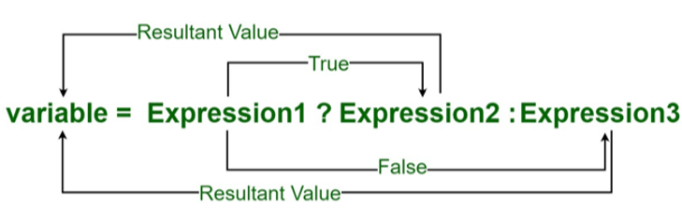
The conditional operator is kind of similar to the if else statement
it does follow the same algorithm as of if else statement but the conditional operator takes less space
Helps to write the if-else statements in the shortest way
CONDITIONAL OPERATOR
Also called as ternary operator

Slide 11
EXAMPLE EXECUTION…..
int num1, num2, max;
printf("Enter two numbers: ");
scanf("%d %d", &num1, &num2);
max = (num1 > num2) ? num1 : num2;
printf("Maximum between %d and %d is %d", num1, num2, max);
So the output will be,
Enter two numbers :
3 7
Maximum between 3 and 7 is 7

Slide 12
EXAMPLE EXECUTION…..
int num1, num2, num3, max;
printf("Enter three numbers: ");
scanf("%d %d %d", &num1, &num2, &num3);
max = (num1 > num2 && num1 > num3) ? num1 :
(num2 > num3) ? num2 : num3;
printf("\n Maximum between %d, %d and %d = %d", num1, num2, num3, max);
So the output will be,
Enter three numbers :
3 7 9
Maximum between 3 ,7 and 9 = 9

Slide 13
SUMMARY…..
In a nutshell we can say, the lecture provided deeper insight into the concept of goto and conditional operator, through their structure and implementation examples the idea about how to program them into changing the flow control of the code and it’s optimization got clear

Slide 14
C program to check whether entered number by the user is prime using goto.
C program to find the factorial of a number entered by the user using goto.
C program to find the sum of first N natural numbers using goto.
C program to print Fibonacci series up to user specifies limit using goto.
C program to check whether a number is palindrome or not using goto.
To find maximum among four numbers using ternary operator c program.
To check the person is eligible for vote or not using conditional operator.
To find maximum among five numbers using ternary operator
FREQUENTLY ASKED QUESTIONS

Slide 15
1. What is the output of the C Program.?
int main ()
{
int a=0;
a = (5>2)?: 8;
printf("%d", a);
return 0; }
2. goto can be used to jump from main to within a function?
A. True
B. False
3. What is the output of C Program.?
int main ()
{
int a=0, b;
a = (5>2)? b=6: b=8;
printf ("%d %d", a, b);
return 0;
}
UTILISE YOUR KNOWLEDGE TO ANSWER

Slide 16
4. Choose a syntax for C Ternary Operator from the list.
A) condition ? expression1 : expression2
B) condition : expression1 ? expression2
C) condition ? expression1 < expression2
D) condition < expression1 ? Expression2
5. What is the output of this C code?
int main ()
{
int x = 2, y = 0;
int z = (y++) ? y == 1 && x : 0;
printf ("%d\n", z);
return 0;
UTILISE YOUR KNOWLEDGE TO ANSWER

Slide 17

DISCUSSION
FORUM
While executing goto statement what do you feel? does it require extra time for carrying a jump either forward or backward by the compiler while executing the code.
Think about a situation where you got a project and it requires branching procedures. You are given an option of choosing between if-else and conditional operator, which one you will choose and tell why?

Slide 18
References
sources | Links/description
Reference Book | [1] Kanetkar, Y. (2010). Let us C. 15th ed. [2] Thareja Reema (2014) Programming in C. 2nd ed. [3] Zed A. Shaw, Learn C the Hard Way’
Reference Website | [1] https://www.programiz.com/c-programming/precedence- associativity-operators [2] https://www.tutorialspoint.com/operator-precedence-and-associativity-in-c
Online Courses | [1] https://www.classcentral.com/course/swayam-introduction-to-programming-in-c-2486 [2] https://www.coursera.org/learn/c-for-everyone

Slide 19
THANK YOU…

